Slide 1
Digital image processing and analysis 15. Multispectral imaging
Professor Ela Claridge
School of Computer Science

Slide 2
Previous lecture:
Statistical shape models
What they are
What they are used for
Principal Component Analysis (PCA)
What it is
How it is used for shape modelling
Point distribution models
Active shape models
Active appearance models

Slide 3
In this lecture we shall find out about:
Multispectral imaging
Why colour that we see does not always tell the full story
General principles of multispectral imaging
How to acquire multispectral images
Analysis and applications

Slide 4

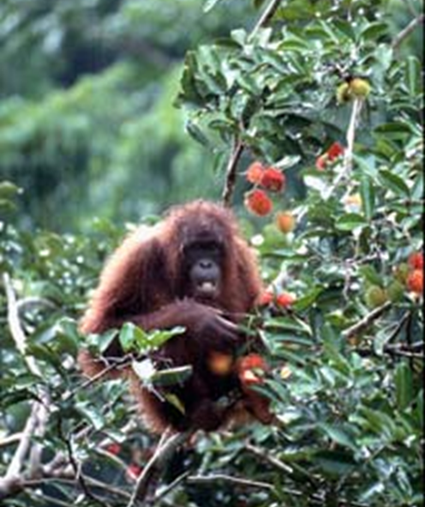
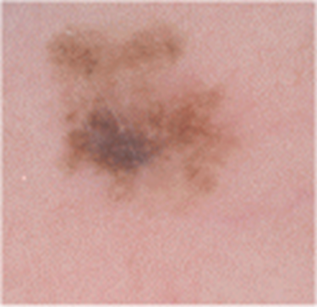
What is perception for?
Quantitative imaging may lay beyond our perception

Slide 5
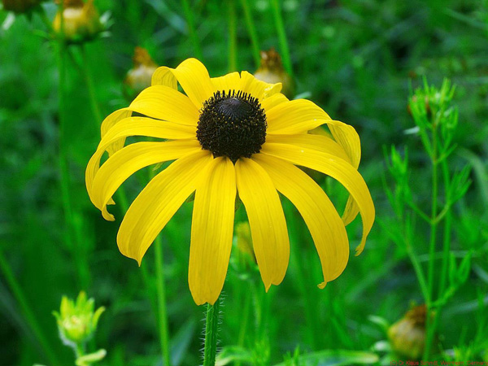
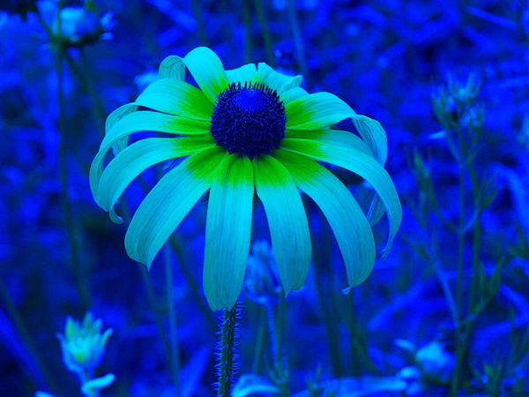
How bees see the world
In the vast electromagnetic spectrum of wavelengths (extending from below the long wavelengths used for radio, to the short wavelengths of gamma radiation) we humans see only a miniscule fraction that we call visible light. This small sliver, spanning the distance between violet and red is the way we perceive the world around us with our eyes. However bees and other insects have a different view of the world. Their whole range of light is shifted further towards the violet end of the spectrum and further from the red. This means that, while they can’t perceive red, they see colours we simply cannot see – what we call ultra-violet. This also means is that bees see a world literally hidden before our eyes.
Human vision
(RGB)
Simulated bee vision
(GB+UV)
https://www.visualnews.com/2013/04/08/hidden-patterns-how-a-bee-sees-the-world-of-flowers/

Slide 6
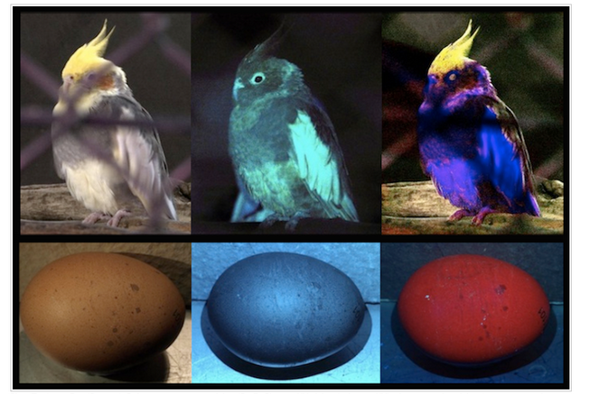
How birds see the world
Human vision
(RGB)
UV vision
(Ultraviolet)
Simulated bird vision
(RGB+UV)

Slide 7
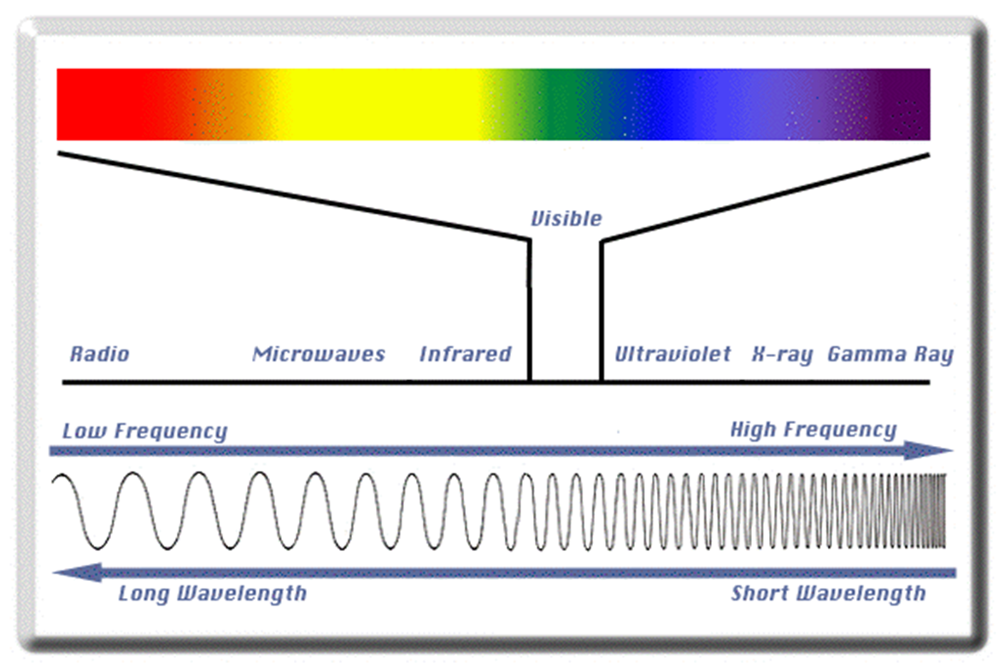
Light – a form of electromagnetic radiation

Slide 8
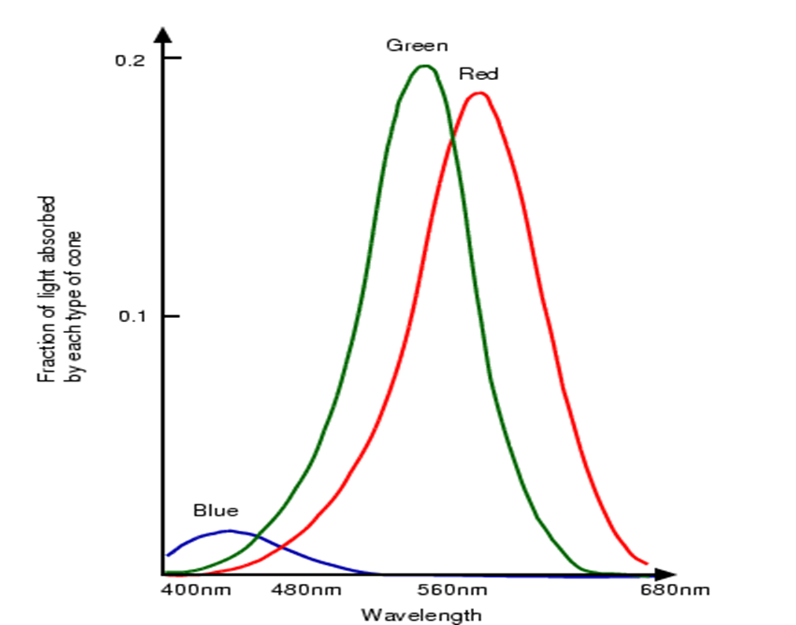
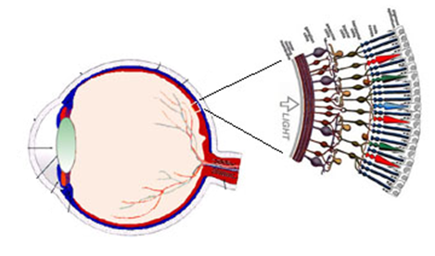
Spectral sensitivity curves for the retinal receptors
Change title
Notes:
The cone cells of the human eye are sensitive to 3 wavelength ranges which the eye interprets as blue (narrow, with a peak near 419 nm), green (broader, with a peak near 531 nm) and red (also broad, with a peak near 558 nm, which is actually more like yellow!):

Slide 9
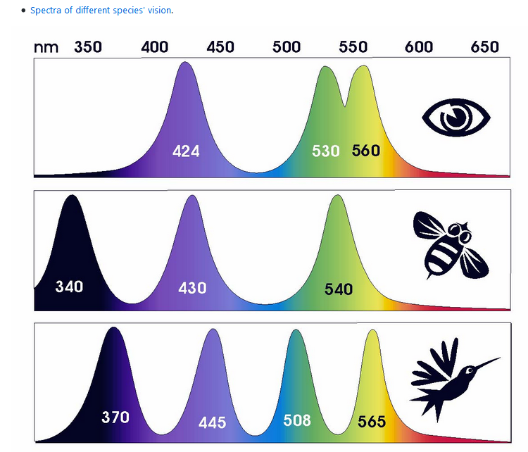
Spectra of different species vision There are things we (humans) cannot see
Humans
Bees
Birds

Slide 10
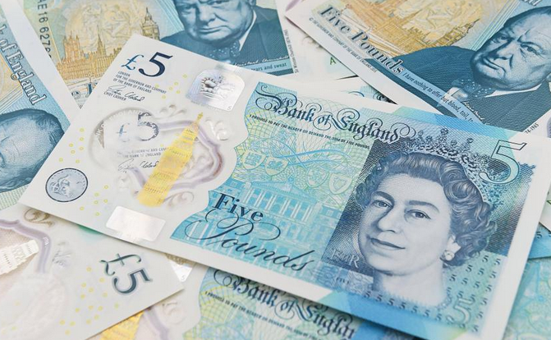
Colour pereception - problems There are things we cannot see

Slide 11
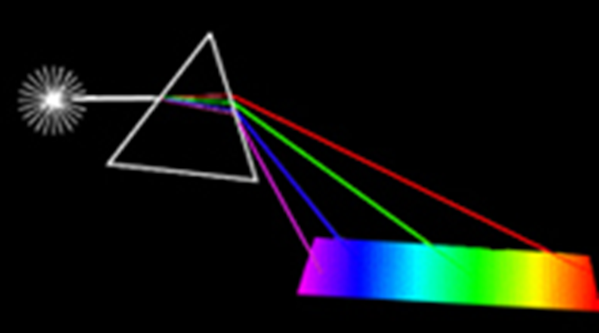
Colour perception – problems Inability to “unmix”
Inability to “unmix”

Slide 12
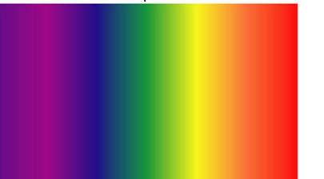
Colour perception – problems Metamerism
650 nm
500 nm
500 nm
580 nm
650 nm
580 nm

Slide 13
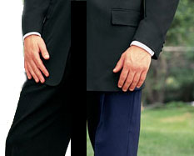
Colour perception – problems Metamerism
Indoors
Outdoors
Two colours that have different spectra look the same to the human eye.
They will appear differently in different illuminating conditions

Slide 14
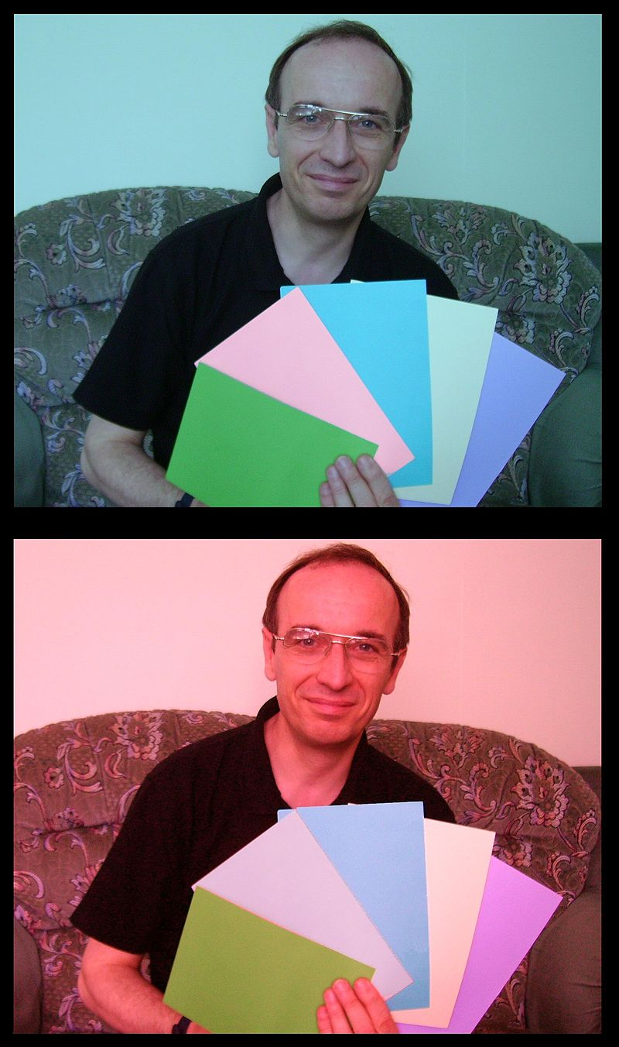
Colour perception – problems Colour constancy
In these two pictures, the second card from the left seems to be a stronger shade of pink in the upper one than in the lower one. In fact they are the same colour (since they have the same RGB values), but perception is affected by the colour cast of the surrounding photo.
Source: Wikipedia

Slide 15
Sensors: limited spectral resolution Both: human eyes and colour cameras
S(λ)
S(λ)
λ(nm)
λ(nm)
400
500
600
700
400
500
600
700

Slide 16
Multispectral and hyperspectral imaging
Reflected, transmitted or emitted light collected by a camera forms an image
Monochrome (B/W) – collects all visible light
Colour – three broad bands (RGB)
Multispectral – several – several tens of bands (broad or narrow)
Hyperspectral – many (hundreds) narrow bands

Slide 17
Multispectral Imaging RGB – broad-band filters
S(λ)
S(λ)
0.6
0.4
0.5
0.6
0.4
0.5
λ(nm)
λ(nm)
400
500
600
700
400
500
600
700
The same RGB image values for different spectral reflectance

Slide 18
Multispectral Imaging Narrow-band filters
S(λ)
S(λ)
0.6
0.7
0.7
0.4
0.3
0.5
0.6
0.8
0.6
0.4
0.4
0.5
0.5
0.5
λ(nm)
λ(nm)
400
500
600
700
400
500
600
700
Different multispectral image values for different spectral reflectance

Slide 19
Why multispectral imaging? Richer interpretation
Example: spectral reflectance curve of the human skin
450 550 650 nm
Wavelength (λ)

Slide 20
Why multispectral imaging?
Full representation of spectral properties
Overcomes problems of human perception
Extends human senses
Multispectral
RGB
Monochrome

Slide 21
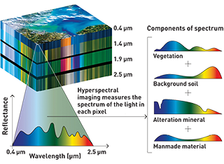
Why multispectral imaging?
X
At the same time …
Y
Full representation of spatial properties
Overcomes the lack of spatial information in point spectroscopy
λ
Hyperspectral cube
(lambda-stack)

Slide 22
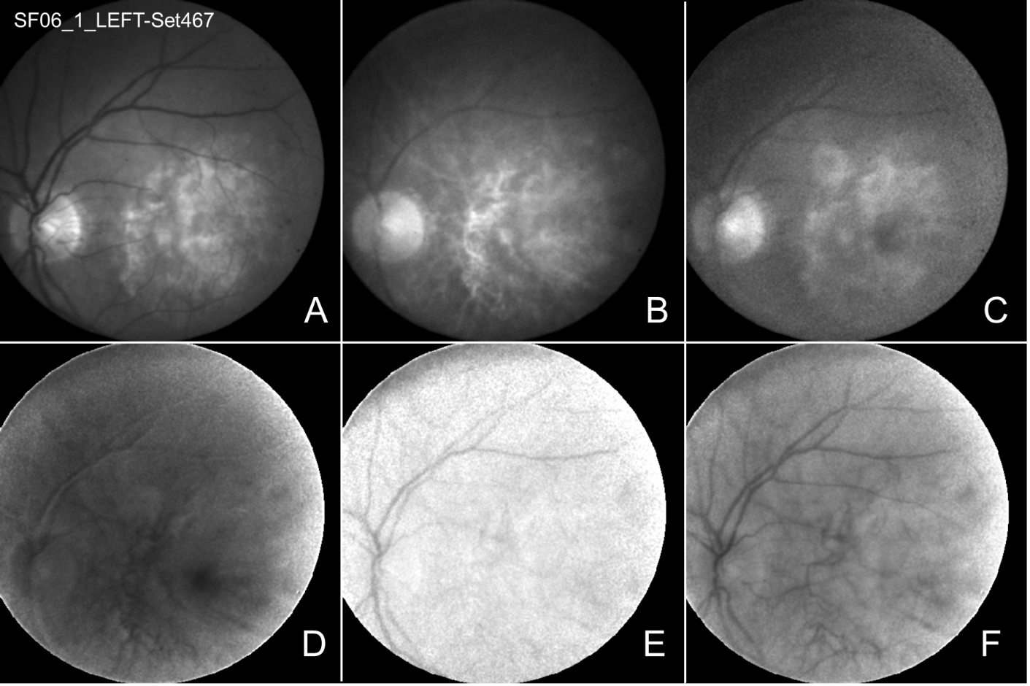
Multispectral image representation
507
525
552
585
611
680

Slide 23

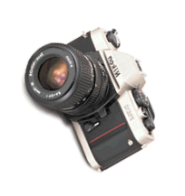
What’s in the image data?
Contributing factors
Illumination
Imaging system
Object

Slide 24
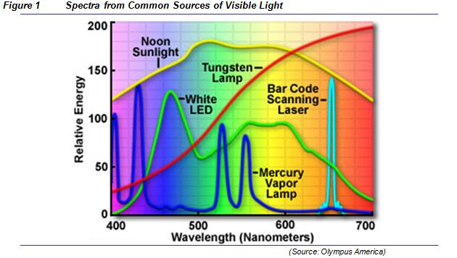
What’s in the image data? Different illumination
Spectra of common sources of visible light

Slide 25
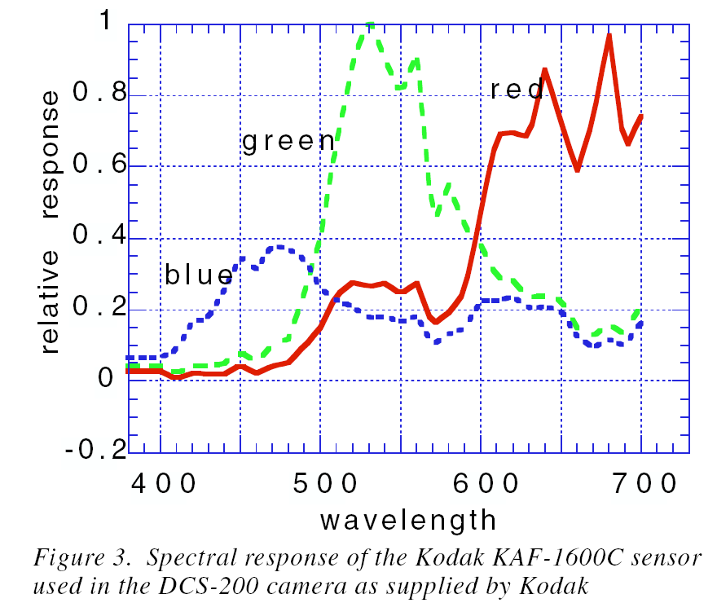
What’s in the image data? Camera sensors

Slide 26
What’s in the image data? Imaging system filters
A filter is a device which selectively transmits light having a particular range of wavelengths while blocking the remainder

Slide 27
What’s in the image data? Calibration and normalisation
To correct interpret image data it is necessary to remove the effects of
Illumination
Imaging system / filters
Acquisition time
Aperture
….
Mathematical techniques for doing so are referred to as “calibration” and “normalisation”.

Slide 28
Acquiring multispectral images
Several ways of obtaining multispectral images
Filter-based devices
Filter wheels
Programmable filters
Diffraction-based devices
Pushbroom imaging
Narrow-band illumination

Slide 29
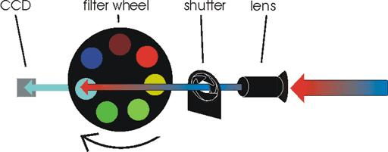
Acquiring multispectral images Filter Wheel
object

Slide 30
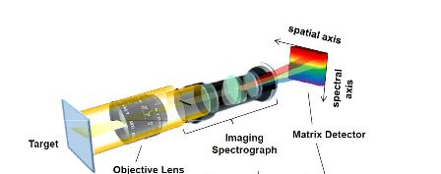
Acquiring multispectral images Pushbroom
Scanning one spatial dimension
Spatial x spectral area scan sensor
Prism or diffraction grating to separate wavelength

Slide 31
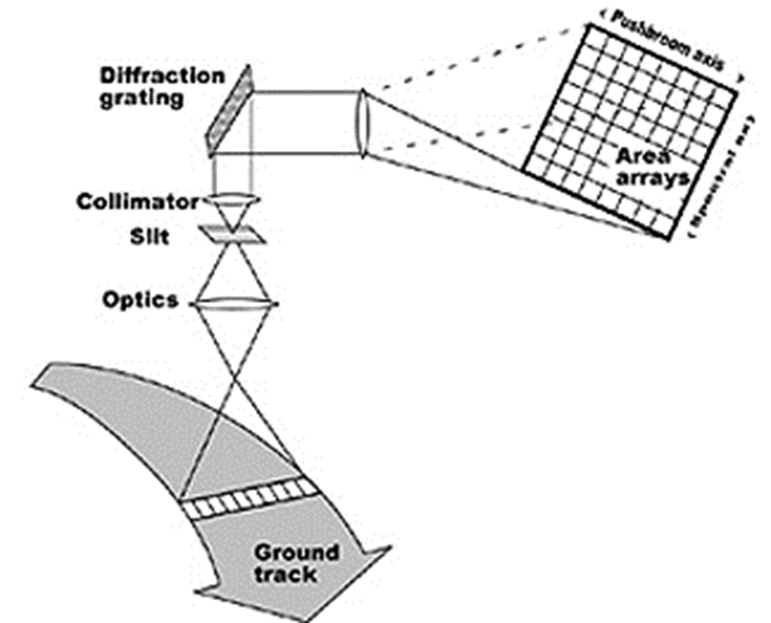
Acquiring multispectral images Pushbroom
λ (spectral)
X (spatial)
Source: http://rst.gsfc.nasa.gov/Intro/pushbroomX.jpg

Slide 32
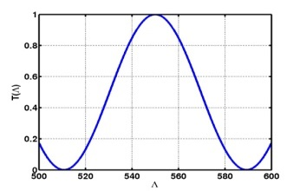
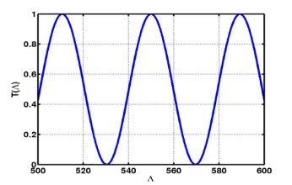
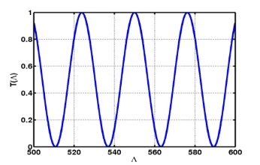
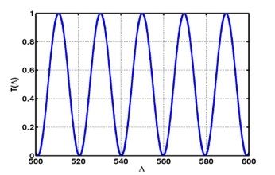
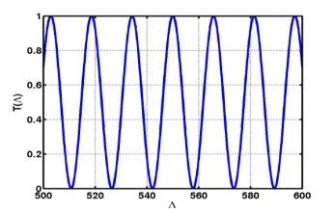
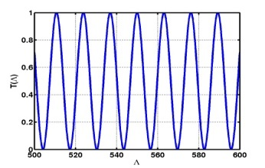
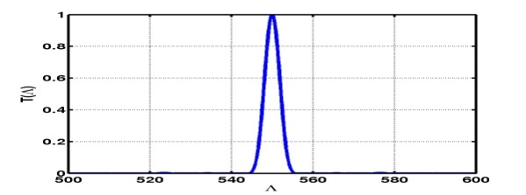
Acquiring multispectral images Programmable Filters
Made of liquid crystal elements.
By switching them on in different combinations, the filter can be configured to pass different wavebands.
Can switch rapidly between bands to duplicate the effect of changing filters in the filter wheel.
One programmable filter can mimic several hundred separate filters.
T1
T2
T3
T4
T5
T6
T1*T2*T3*T4*T5*T6

Slide 33
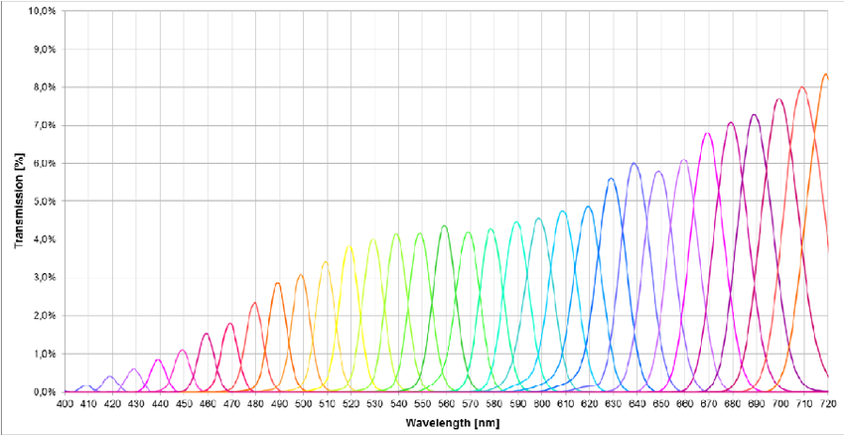
Acquiring multispectral images Programmable Filters
QE for VariSpec (C.R.I.) programmable filter

Slide 34
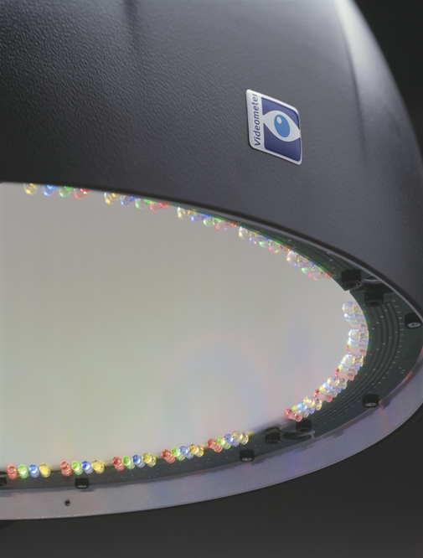
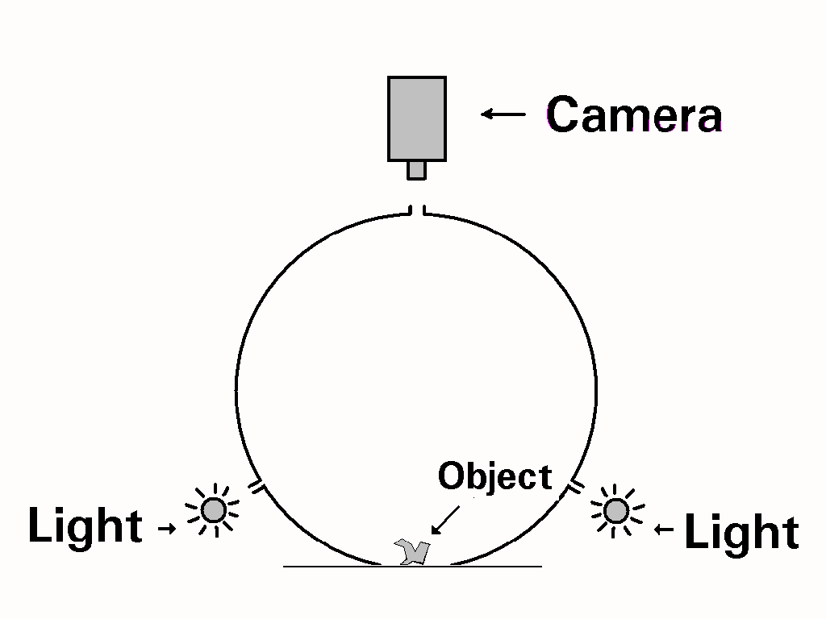
Acquiring multispectral images Narrow band illumination
LEDs as light source
Integrating sphere
Uniform, diffuse
illumination
Notes:
34

Slide 35
Multispectral image analysis Measurable properties
Reflectance
Absorption
Emission
Depth of penetration

Slide 36
Multispectral imaging Applications

Slide 37
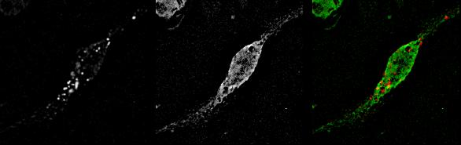
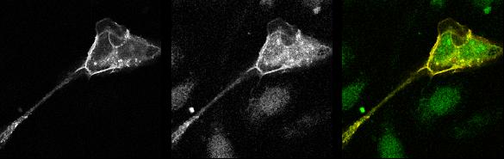
Kinds of applications Visualisation
Proteins interacting
Fluorescence levels imaged through filter centred at λ1
Fluorescence at λ2
λ1 mapped to red
λ2 mapped to green
Where fluorescence is coincident at λ1 and λ2, we see yellow as superposition of red and green

Slide 38
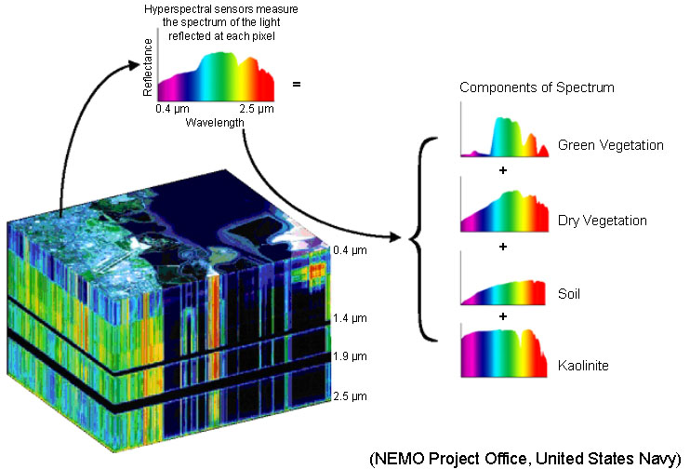
Kinds of applications Classification
Library
http://www.space.gc.ca/asc/eng/satellites/hyper_brochure.asp

Slide 39
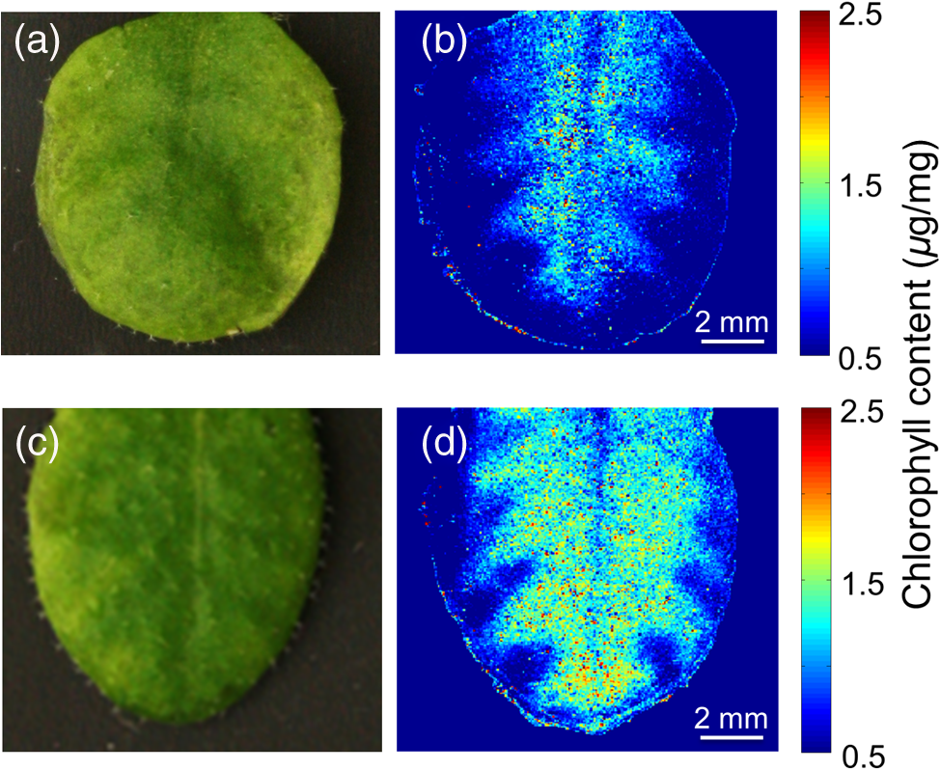
Kinds of applications Quantitative analysis
http://biomedicaloptics.spiedigitallibrary.org/data/journals/biomedo/934852/jbo_21_1_016008_f003.png

Slide 40
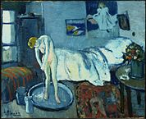
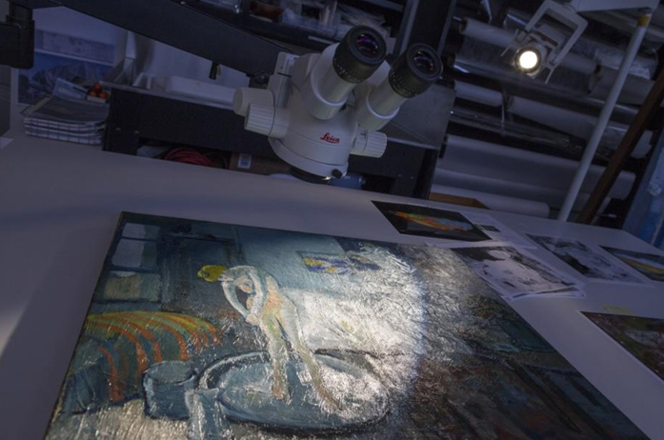
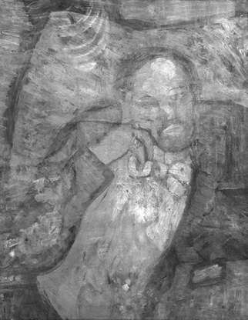
Application areas Arts
http://thecreatorsproject.vice.com/blog/how-art-experts-discovered-a-hidden-portrait-beaneath-a-picasso-masterpiece

Slide 41
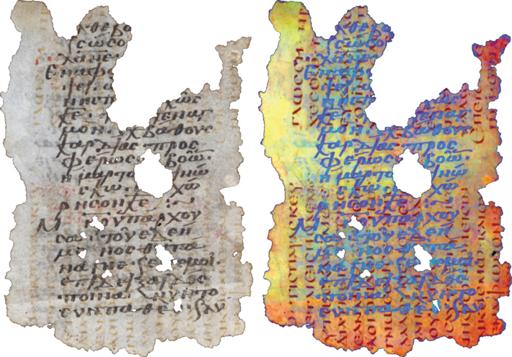
Application areas Archeology
In 1996, a Georgian scholar used ultraviolet light to read a Sinai palimpsest with an overtext in medieval Georgian. He found that the underlying text was written in Caucasian Albanian, and was the first example of a text written in this now-extinct language.
http://www.archaeology.org/issues/207-1603/features/4155-egypt-monastery-palimpsests#art_page2

Slide 42
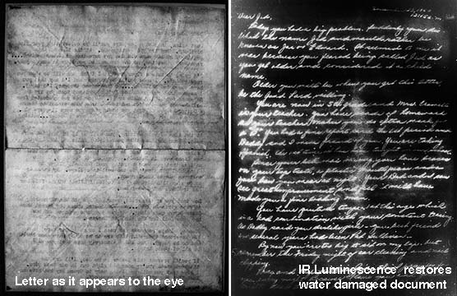
Application areas Restoration
https://people.rit.edu/andpph/photofile-b/ir-letter-comparison-1.jpg

Slide 43
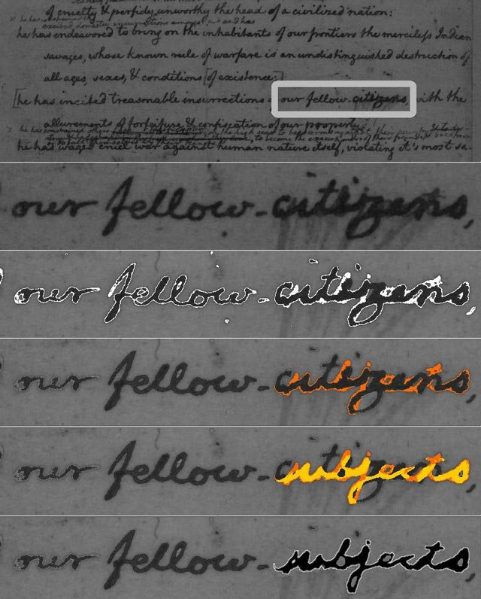
Application areas History
Multispectral analysis of a document in the Library of Congress revealed that a draft of the Declaration of Independence originally named Americans "subjects" instead of "citizens".
http://boingboing.net/2014/06/17/hidden-painting-found-under-pi.html

Slide 44
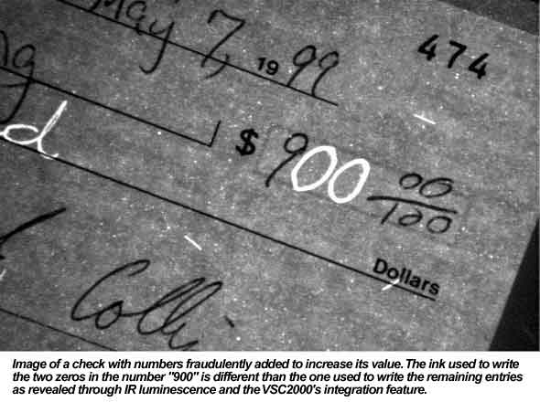
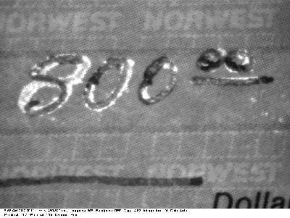
Application areas Forensics
https://github.com/golanlevin/ExperimentalCapture/blob/master/docs/hyperspectral.md

Slide 45
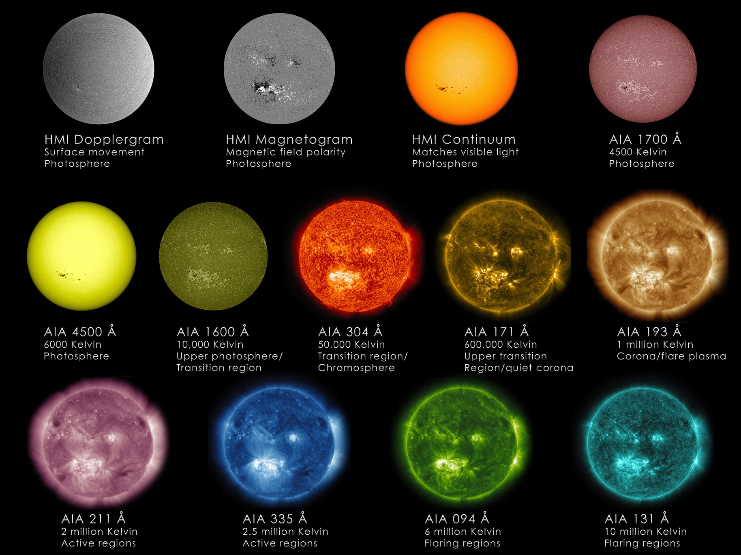
Application areas Astronomy
Astronomers use multispectral imaging to understand the Sun.

Slide 46
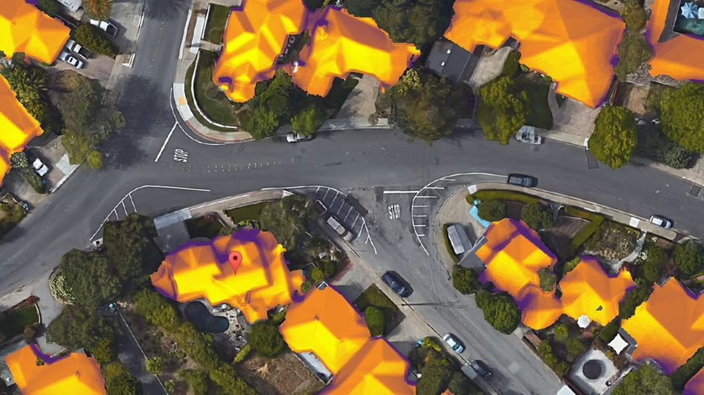
Application areas Environment
Google has recently made satellite thermal imaging of roofs available to the public, to prompt people's awareness about the heat inefficiency of their homes.

Slide 47
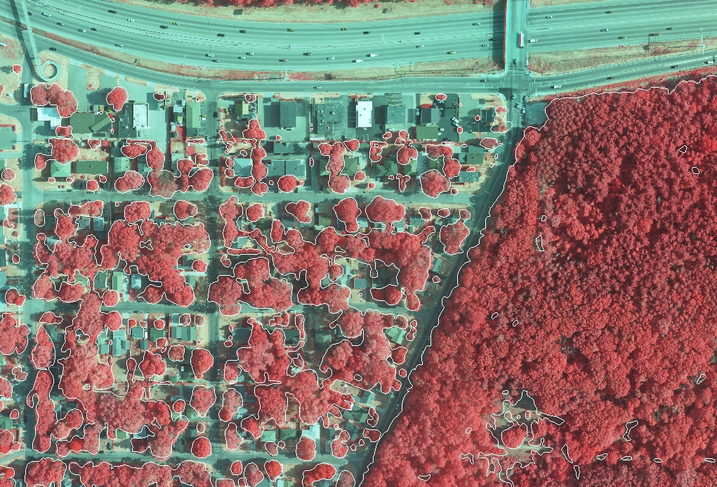
Application areas Environment
4-band multispectral imagery.
The infrared band responds to the chlorophyll found in vegetation and allows for the identification and examination of urban tree canopies.
http://www.ayresgeospatial.com/2014/04/18/geospatial-solutions-for-urban-forest-management/

Slide 48
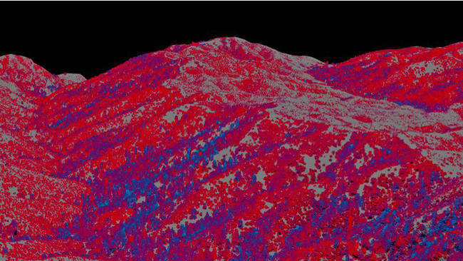
Application areas Environment
The spectrometer works in conjunction with a laser that fans out beneath the aircraft, creating a 3-D image of the forest below.
By marrying the data from the spectrometer and the laser, topographic images created show the condition of the forest. Healthy trees are blue, and drought-stressed trees run from mild (yellow) to severe (red).

Slide 49
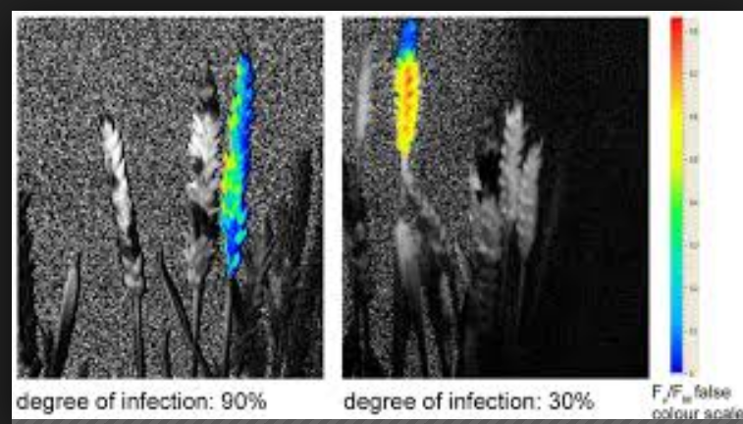
Application areas Agriculture
Hyperspectral and chlorophyll fluorescence Imaging for early detection of plant diseases, with Special Reference to Fusarium spec. Infections on Wheat
http://www.mdpi.com/2077-0472/4/1/32

Slide 50
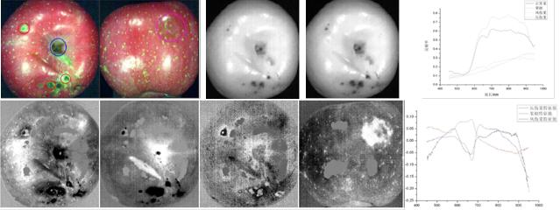
Application areas Agriculture
Healthy and damaged fruit areas show different reflectance spectra.

Slide 51


Application areas Thermal imaging

Slide 52

Application areas Medicine
Thermal imaging

Slide 53

Application areas Medicine
Thermal imaging of the skin burns

Slide 54



Application areas Quality control
Fusarium detection
VideometerLab Multispectral Imaging System
Out of range tablet identification
http://analytik.co.uk/product/multispectral-imaging-videometerlab-analyser/

Slide 55

Application areas Security
Millimeter wave and Terahertz imaging
https://github.com/golanlevin/ExperimentalCapture/blob/master/docs/hyperspectral.md

Slide 56
Research at Birmingham Multispectral imaging for medical diagnosis

Slide 57





Research at Birmingham Early diagnosis of skin cancer
Colour
Epidermal melanin
Dermal melanin
Collagen
Blood
Preece S and Claridge E (2004) Spectral filter optimisation for the recovery of parameters which describe human skin.
IEEE Trans. PAMI 26(7), 913-922.

Slide 58
Research at Birmingham Early diagnosis of skin cancer
SIAscopy / MoleMate
Claridge E, Cotton S, Moncrieff M, Hall P (2006) Spectrophotometric Intracutaneous Imaging (SIAscopy): Method and clinical applications. Chapter 37 in Handbook of Non-Invasive Methods and the Skin (2nd ed). Serup J, Jemec GBE, Grove G (Eds), 315-325: CRC Press.

Slide 59



Research at Birmingham Burns assessment
Blood perfusion
Pigment damage
SIAscopy

Slide 60


Research at Birmingham Detecting diabetic complications in the eye
Image of retina
Haemoglobin map

Slide 61

Research at Birmingham Signs of age related macular degeneration
Macular pigment maps
Styles IB, Calcagni A, Claridge E, Orihuela Espina F, Gibson JM (2006) Quantitative analysis of multispectral fundus images.
Medical Image Analysis 10(4), 578-597.

Slide 62

Research at Birmingham Skin pigment maps
Colour
Haemoglobin
Melanin
http://www.cs.bham.ac.uk/~exc/Research/projects.php
http://www.cs.bham.ac.uk/~exc/Research/publications.php

Slide 63
In this lecture we have covered:
Multispectral imaging
Why colour that we see does not always tell the full story
General principles of multispectral imaging
How to acquire multispectral images
Applications

Slide 64
Next lecture:
Overview and summary of the course
Structure of the exam paper
Revising for the exam

Slide 65
Further reading and experimentation
Links to the articles and image sources are included in the individual slides, where relevant.

